Slide 1
Analysis of Customer purchasing behaviours
Marketing Analytics

Slide 2
Agenda
Objective
About Data
Exploratory Data Analysis
Advance Exploratory Data Analysis
Factor Analysis
Clustering Analysis
Conclusion

Slide 3

Objective
The goal of this analysis Case Study is to discover the Customer Segmentation of a bank, by looking through their behaviour while using Credit Card. So that I can find the clear segmentation of the customer, so we can deploy effective marketing campaign or sales promotion to the targeted costumer.

Slide 4
About Data
The sample dataset summarizes the usage behavior of about 9000 active credit card holders during the last 6 months. The file is at a customer level with 18 behavioral variables.
Some Feature :
BALANCE: Monthly average balance (based on daily balance averages)
PURCHASES: Total purchase amount spent during last 12 months
PURCHASES_ FREQUENCY: Frequency of purchases (Percent of months with at least one purchase)

Slide 5
About Data
PURCHASES_INSTALLMENTS_FREQUENCY: Frequency of installment purchases
AVERAGE_PURCHASE_TRX: Average amount per purchase transaction
PURCHASES_TRX: Average amount per purchase transaction
PAYMENTS: Total payments (due amount paid by the customer to decrease their statement balance) in the period
CASH_ADVANCE: Total cash-advance amount
PURCHASES_ FREQUENCY: Frequency of purchases (Percent of months with at least one purchase)

Slide 6
Exploratory Data Analysis
 | BALANCE | BALANCE_FREQUENCY | PURCHASES | ONEOFF_PURCHASES
count | 8949 | 8949 | 8949 | 8949
mean | 1564.64759 | 0.877350132 | 1003.316936 | 592.5035725
std | 2081.58402 | 0.236798099 | 2136.727848 | 1659.968851
min | 0 | 0 | 0 | 0
25% | 128.365782 | 0.888889 | 39.8 | 0
50% | 873.680279 | 1 | 361.49 | 38
75% | 2054.37285 | 1 | 1110.17 | 577.83
max | 19043.1386 | 1 | 49039.57 | 40761.25

Slide 7
Exploratory Data Analysis
 | INSTALLMENTS_PURCHASES | CASH_ADVANCE | PURCHASES_FREQUENCY | ONEOFF_PURCHASES_FREQUENCY
count | 8949 | 8949 | 8949 | 8949
mean | 411.1135792 | 978.959616 | 0.490405342 | 0.202480307
std | 904.3782052 | 2097.264344 | 0.401359697 | 0.298345057
min | 0 | 0 | 0 | 0
25% | 0 | 0 | 0.083333 | 0
50% | 89 | 0 | 0.5 | 0.083333
75% | 468.65 | 1113.868654 | 0.916667 | 0.3
max | 22500 | 47137.21176 | 1 | 1

Slide 8
Exploratory Data Analysis
 | PURCHASES_INSTALLMENTS FREQUENCY | CASH_ADVANCE FREQUENCY | CASH_ADVANCE_TRX | PURCHASES_TRX
count | 8949 | 8949 | 8949 | 8949
mean | 0.364478065 | 0.135140678 | 3.249078109 | 14.71147614
std | 0.397451314 | 0.200132293 | 6.824986674 | 24.85855164
min | 0 | 0 | 0 | 0
25% | 0 | 0 | 0 | 1
50% | 0.166667 | 0 | 0 | 7
75% | 0.75 | 0.222222 | 4 | 17
max | 1 | 1.5 | 123 | 358

Slide 9
Exploratory Data Analysis
 | CREDIT_LIMIT | PAYMENTS | MINIMUM PAYMENTS | PRC FULL PAYMENT | TENURE
count | 8949 | 8949 | 8949 | 8949 | 8949
mean | 4494.44945 | 1733.336511 | 844.999569 | 0.153731825 | 11.517935
std | 3638.815725 | 2895.168146 | 2332.906149 | 0.292511026 | 1.3371339
min | 50 | 0 | 0.019163 | 0 | 6
25% | 1600 | 383.28285 | 170.875613 | 0 | 12
50% | 3000 | 857.062706 | 312.343947 | 0 | 12
75% | 6500 | 1901.27932 | 788.721609 | 0.142857 | 12
max | 30000 | 50721.48336 | 76406.20752 | 1 | 12

Slide 10
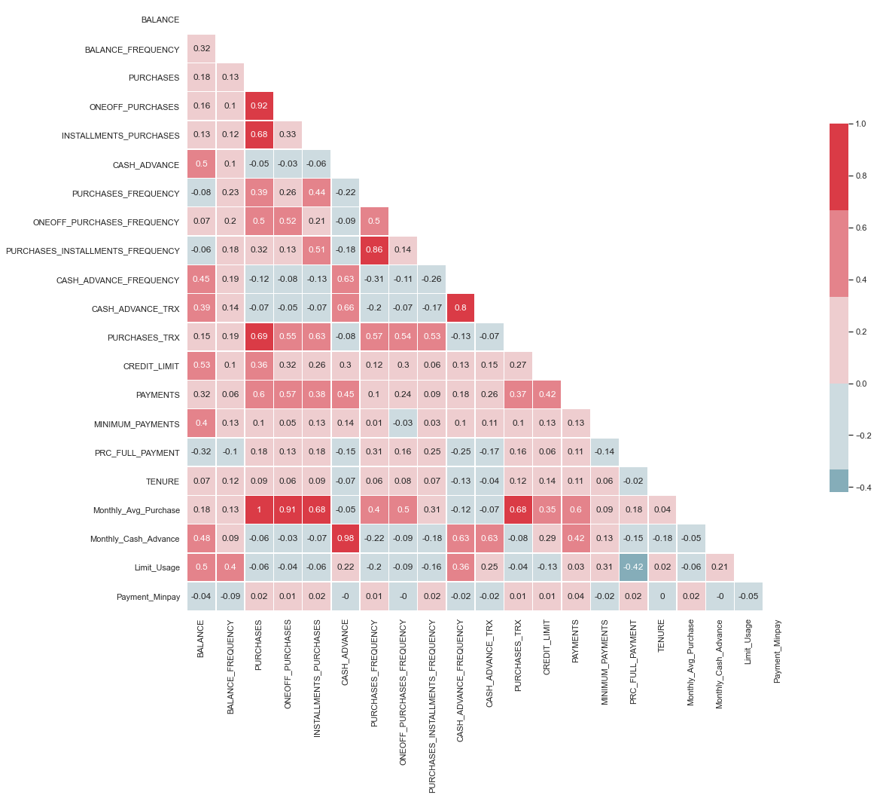
Exploratory Data Analysis

Slide 11
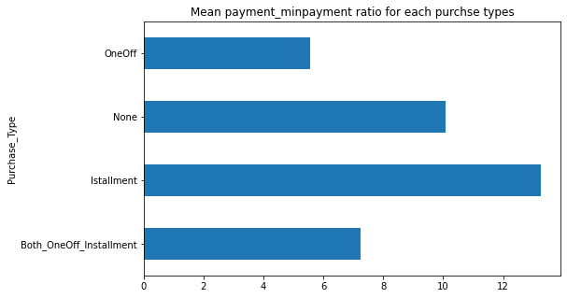
Advance Exploratory Data Analysis
Customer who do the purchase on instalment have high mean minpayment ratio

Slide 12
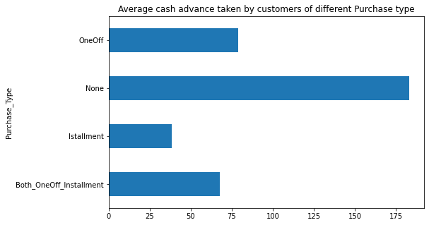
Advance Exploratory Data Analysis

Slide 13
Advance Exploratory Data Analysis

Slide 14
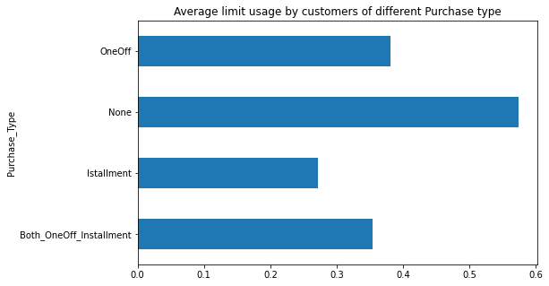
Advance Exploratory Data Analysis

Slide 15
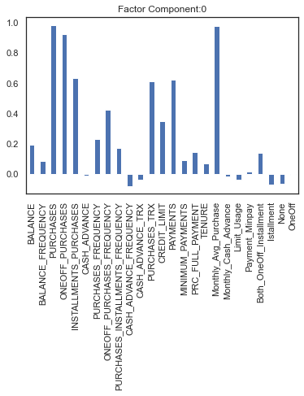
Factor Analysis
Factor 1 has high factor loadings for PURCHASES, Monthly_Avg_Purchase, ONEOFF_PURCHASES,INSTALLMENTS_PURCHASES ,PAYMENTS, PURCHASES_TRX,ONEOFF_PURCHASES_FREQUENCY

Slide 16
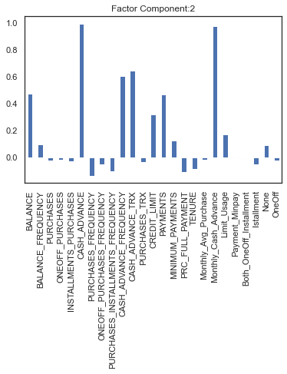
Factor Analysis
Factor 2 has high factor loadings for CASH_ADVANCE, Monthly_Cash_Advance,CASH_ADVANCE_TRX,CASH_ADVANCE_FREQUENCY

Slide 17
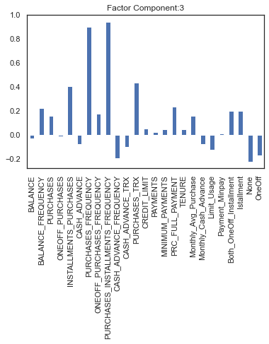
Factor Analysis
Factor 3 has high factor loadings for CASH_ADVANCE, Monthly_Cash_Advance, CASH_ADVANCE_TRX, CASH_ADVANCE_FREQUENCY

Slide 18
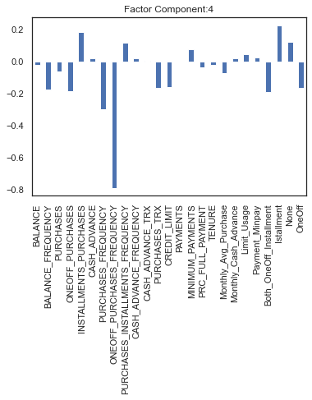
Factor Analysis
Factor 4 has high factor loadings for ONEOFF_PURCHASES_FREQUENCY, PURCHASES_FREQUENCY

Slide 19
Clustering Analysis
Cluster1 | count | mean
PURCHASES_INSTALLMENTS_FREQUENCY | 1080 | 0.865667276
PURCHASES_FREQUENCY | 1080 | 0.923343301
PURCHASES_TRX | 1080 | 45.46296296
INSTALLMENTS_PURCHASES | 1080 | 1736.997352
PRC_FULL_PAYMENT | 1080 | 0.273998803
BALANCE_FREQUENCY | 1080 | 0.959890826
Both_OneOff_Installment | 1080 | 0.716666667
CASH_ADVANCE_FREQUENCY | 1080 | 0.08227441
None | 1080 | 0
Limit_Usage | 1080 | 0.332933432
OneOff | 1080 | 0
Cluster2 | count | mean
PURCHASES_INSTALLMENTS_FREQUENCY | 60 | 0.9175
PURCHASES_FREQUENCY | 60 | 0.941389
PURCHASES_TRX | 60 | 119.0667
INSTALLMENTS_PURCHASES | 60 | 7722.674
PRC_FULL_PAYMENT | 60 | 0.346423
BALANCE_FREQUENCY | 60 | 0.980152
Both_OneOff_Installment | 60 | 0.833333
CASH_ADVANCE_FREQUENCY | 60 | 0.0625
None | 60 | 0
Limit_Usage | 60 | 0.41466
OneOff | 60 | 0

Slide 20
Clustering Analysis
Cluster3 | count | mean
PURCHASES_INSTALLMENTS_FREQUENCY | 7809 | 0.290914
PURCHASES_FREQUENCY | 7809 | 0.427064
PURCHASES_TRX | 7809 | 9.656678
INSTALLMENTS_PURCHASES | 7809 | 171.5633
PRC_FULL_PAYMENT | 7809 | 0.135618
BALANCE_FREQUENCY | 7809 | 0.865145
Both_OneOff_Installment | 7809 | 0.249712
CASH_ADVANCE_FREQUENCY | 7809 | 0.14301
None | 7809 | 0.261365
Limit_Usage | 7809 | 0.396473
OneOff | 7809 | 0.23998

Slide 21
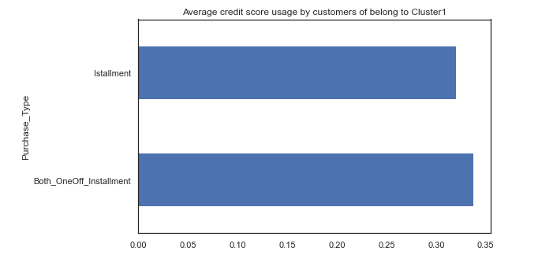
Clustering Analysis
Cluster1

Slide 22
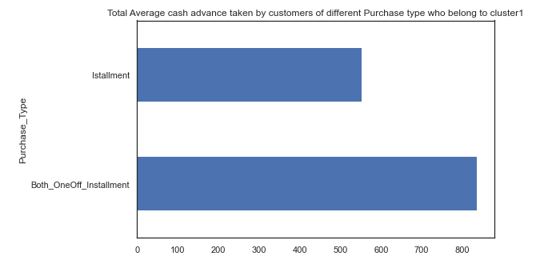
Clustering Analysis
Cluster1

Slide 23
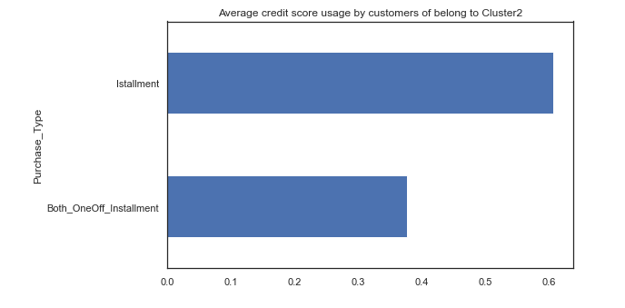
Clustering Analysis
Cluster2

Slide 24
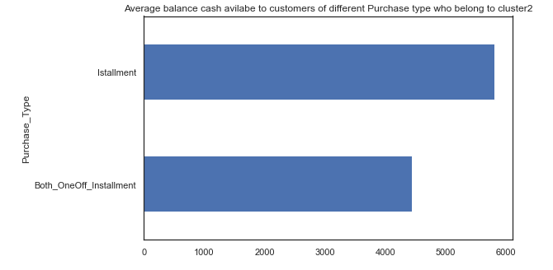
Clustering Analysis
Cluster2

Slide 25
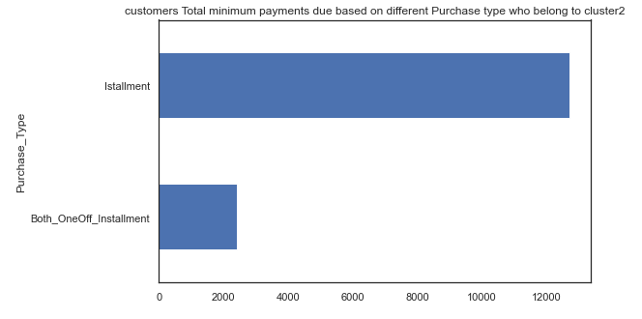
Clustering Analysis
Cluster2

Slide 26
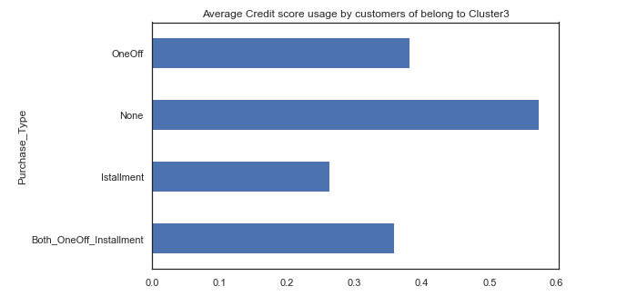
Clustering Analysis
Cluster3

Slide 27
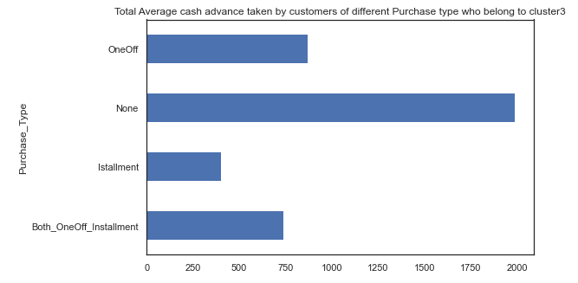
Clustering Analysis
Cluster3

Slide 28
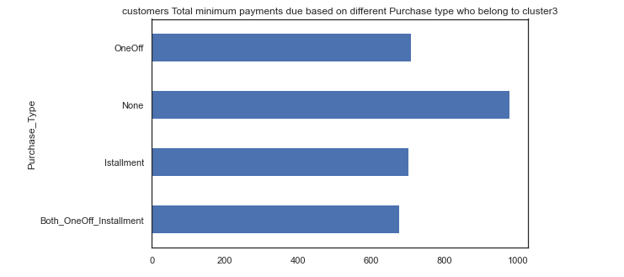
Clustering Analysis
Cluster3

Slide 29
Clustering Analysis
In Clusters 3 actually a quite potential Customers. They give a lot cash in advance, but unfortunately their spending on purchases is still minimum. We should attract them to apply installment even with the 0% interest at the beginning.
In Clusters 2 we see Customer is smart, they give minimum payment to purchase in installment however the no of customer not so enough to give minimum payment for both types purchase oneoff & installment
In Cluster 1 we see the avg credit score is high of customer who purchases using Oneoff and installment as compare to customer who purchases using installment only

Slide 30
Thank You!

